Slide 1
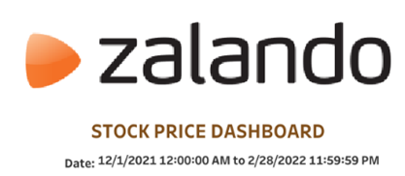
Zalando SE Stock Price Analysis
Insights and Recommendations

Slide 2

Zalando SE Overview:
Market Presence: Zalando in 20+ EU countries, 42M+ active customers.
Product Range: 400K+ products, 3K+ brands, vast selection.
Digital Innovation: Personalized recs = 30% sales, tech-driven.
Sustainability: Net-zero emissions by 2025, -34% emissions/parcel vs. 2017.
Financial Performance: Revenue €380-450M, ↑ from €350M in 2023

Slide 3
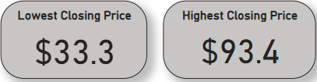
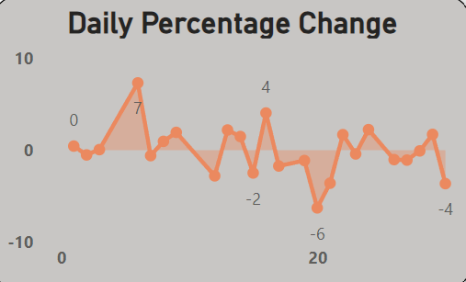
Stock Price Highlights
Highest Price: $93.4
Lowest Price: $33.3
Daily Changes : Between --10% to +10%.

Slide 4
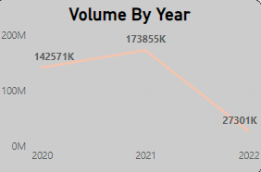
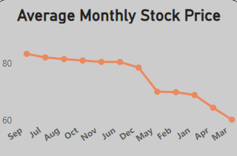
Trading Volume
Yearly Volume:
2020:142571 k shares
2021:173855 k shares
2022: 2730 k shares
Monthly Average: Fluctuates throughout the year

Slide 5
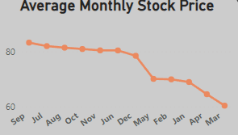
Monthly Stock Price Trends
High Months: September, October
Low Months: February, March
Stock Price Range:
Highest Closing Price: $80 (approx. from the chart)
Lowest Closing Price: $60 (approx. from the chart)

Slide 6
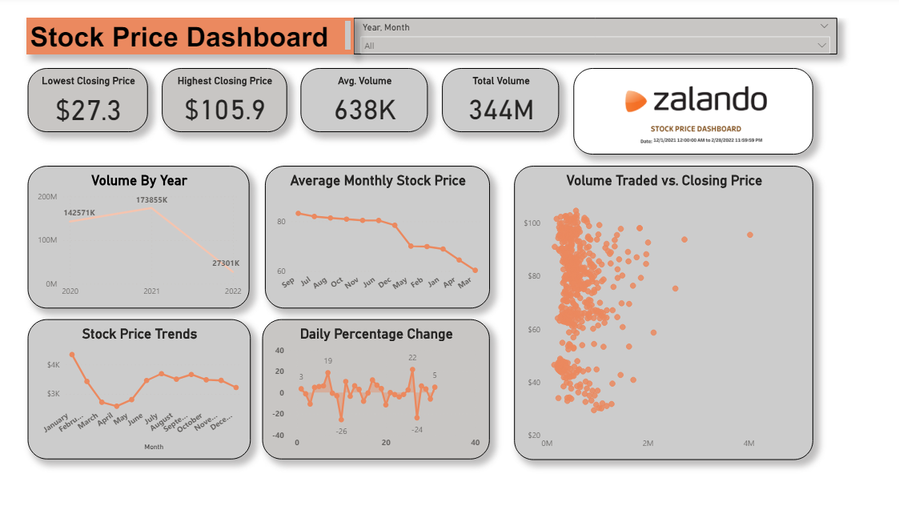
Dashboard Insights
Tools Used: Power BI (DAX)
Interactive filters for detailed analysis

Slide 7
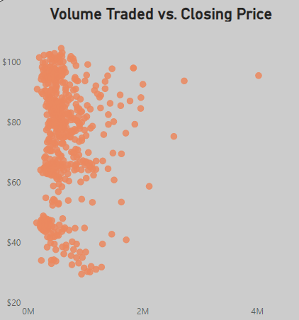

Insights
Daily Percentage Change: - The stock price exhibited significant daily fluctuations, with changes ranging between -10% and +10%
Volume Traded: - The volume of traded stock varies significantly by year, with 173,855K shares traded in one of the recent years as a peak
Average monthly traded volume shows significant variation, suggesting fluctuating investor interest and market activity throughout the year

Slide 8
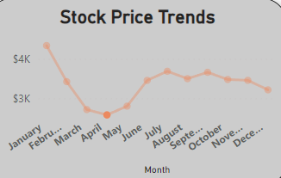
Insights
Average Monthly Stock Price : The average monthly stock price shows a clear trend, with noticeable peaks and troughs indicating periods of high and low stock prices throughout the year. Specific months such as September and October showed higher average prices, whereas months like February and March showed lower averages.
Stock Price Range:
Highest Closing Price: Approximately $80
Lowest Closing Price: Approximately $60
Stock Price Trends Visualization: The provided dashboard in Power BI offers interactive features such as date range filters and visual interactions to help stakeholders better understand and analyze stock price movements

Slide 9
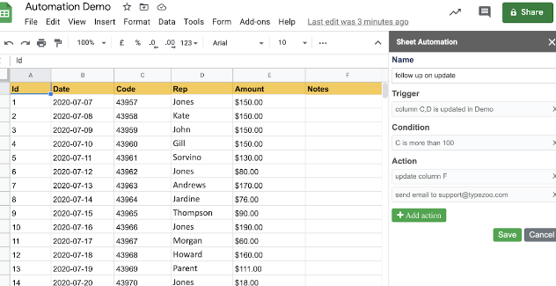
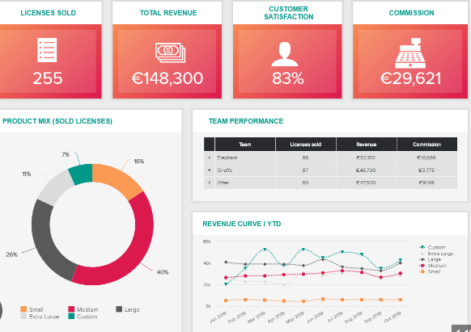
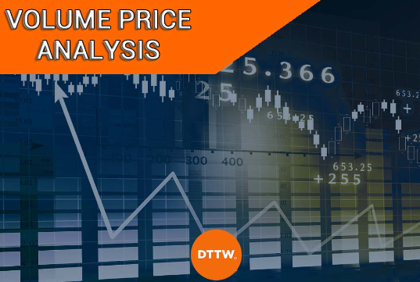
Recommendations
Daily Updates and Automation:
Use Google Sheets for automation.
Ensure daily stock price updates.
Enhanced Dashboard Features:
Improve Tableau and Power BI.
Add granular filters and predictive analytics.
Volume and Price Analysis:
Analyze correlation between volume, price.
Understand market behavior and sentiment.

Slide 10


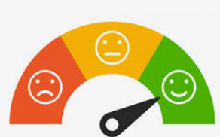
Recommendations
Risk Management: Implement stop-loss orders.
Utilize hedging strategies for protection.
Stakeholder Reports: Develop clear, visual reports.
Include comprehensive analysis of trends.
Market Sentiment Analysis: Utilize tools to analyze sentiment.
Gain insights from various sources.

Slide 11

By implementing these recommendations, Zalando SE can enhance its stock price analysis, provide better insights to stakeholders, and make more informed strategic decisions.
THANK YOU!

